Slide 1
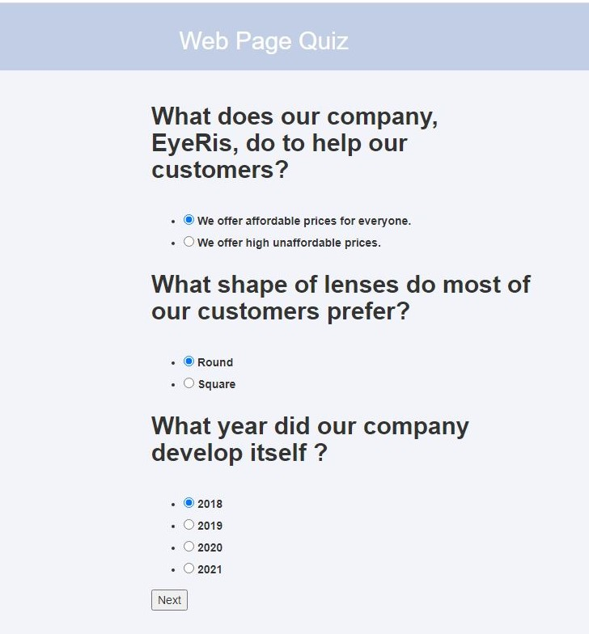


EyeRis Web Quiz
Developer: Diana Bounyasith
A simple quiz you can change and incorporate into any website.
Gitub Repository URL: https://github.com/ksu-is/EyeRis-Web-Quiz

